Slide 1
“Accurate and interpretable methodologies for predicting clinically-relevant outcomes in cancer research”
Interpreting Random Forest with Ensemble Networks for Omics Data Analysis
Yue Zhang

Slide 2
About the project
Machine learning approach
Support
Biomedical research
Goal: Developing an interpretation module for Random Forest which can provide biological meaningful local interpretations
Models trained with Omics data
Focus on
Interpretability of the Random Forest
Notes:
Local interpretation could be crucial in biomedical and/or pre-clinical ML applications
Omics data naturally carries biological meaningful information but was rarely studied in ML interpretation

Slide 3
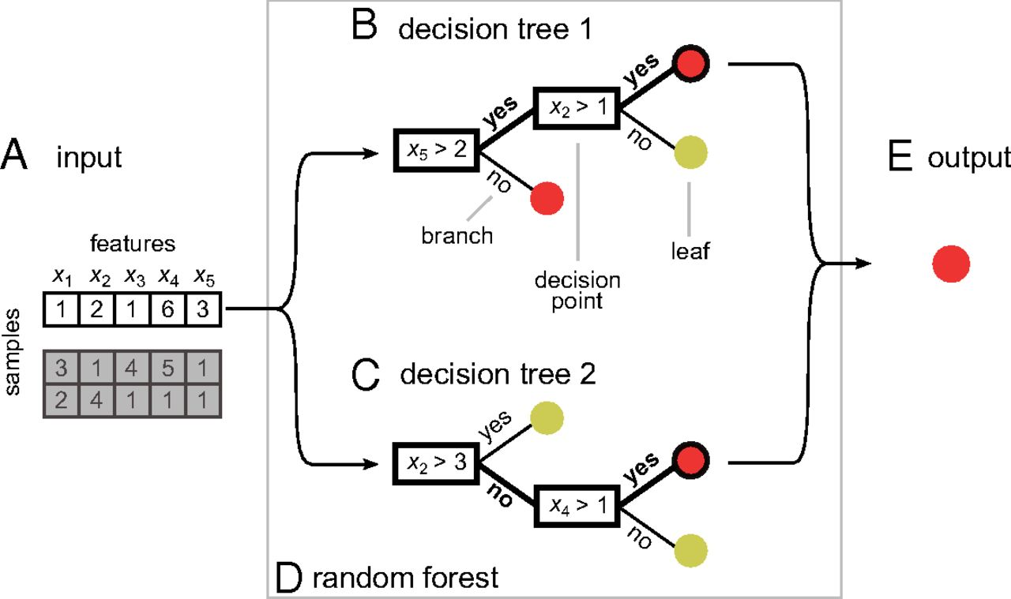
Random Forest
Denisko, Danielle and Hoffman, Michael M. Classification and interaction in random forests. Proceedings of the National Academy of Sciences. 2018
Notes:
Talk about ensemble here

Slide 4
Existing method for Random Forest Interpretation
Shapley values
Feature importance measurement
Don’t consider the possible synergy effect between biological molecules, therefore not optimum for applications in the biological/medical field
Model Agnostic
Random Forest-specific
LIME
Model Agnostic

Slide 5
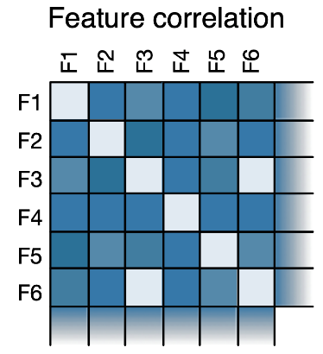
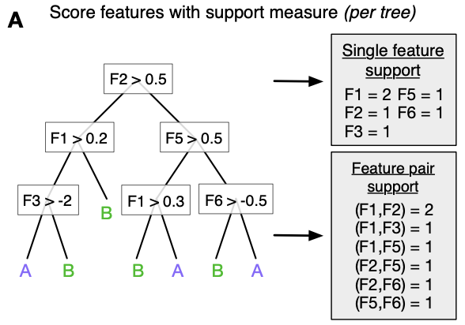
Existing method for Random Forest Interpretation
Foresight
Random Forest-specific
Biological oriented
Only provides a global interpretation of the model, the explanation of each prediction is not provided
Purely based on the times of features co-occurrences, doesn’t use the node splitting information in the RF

Slide 6
Ensemble to interpret biologically
Getting pieces of biological information from the forest
Imaging this is a cell
Assumption: The nodes in the same decision path are more likely to be biologically relevant with each other comparing to nodes in different paths
Contributes more for separating two classes
Notes:
Talk about ensemble interpretation

Slide 7
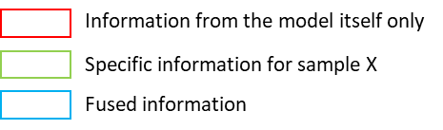
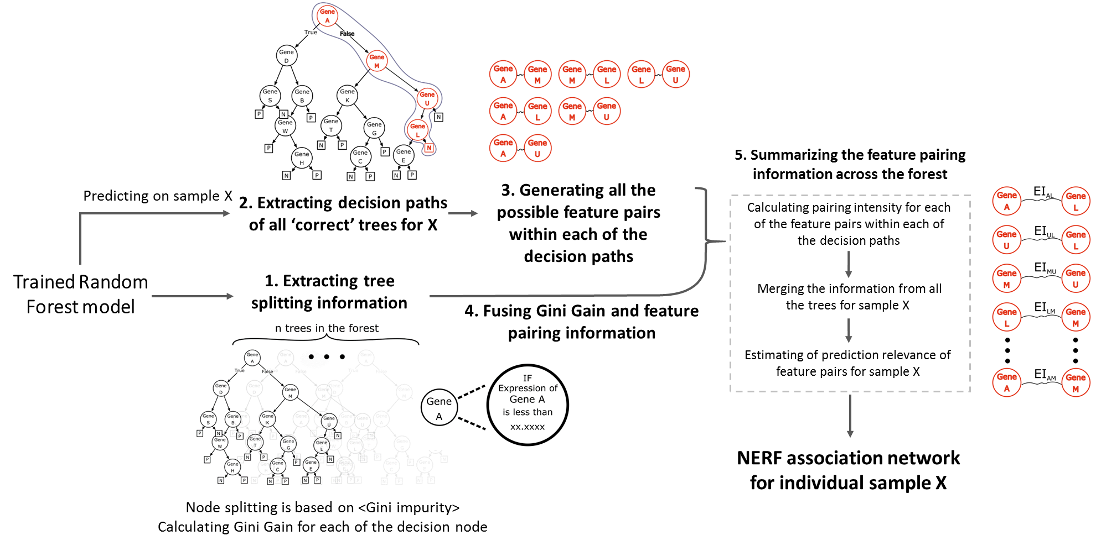
Network Explainer of Random Forest - NERF

Slide 8
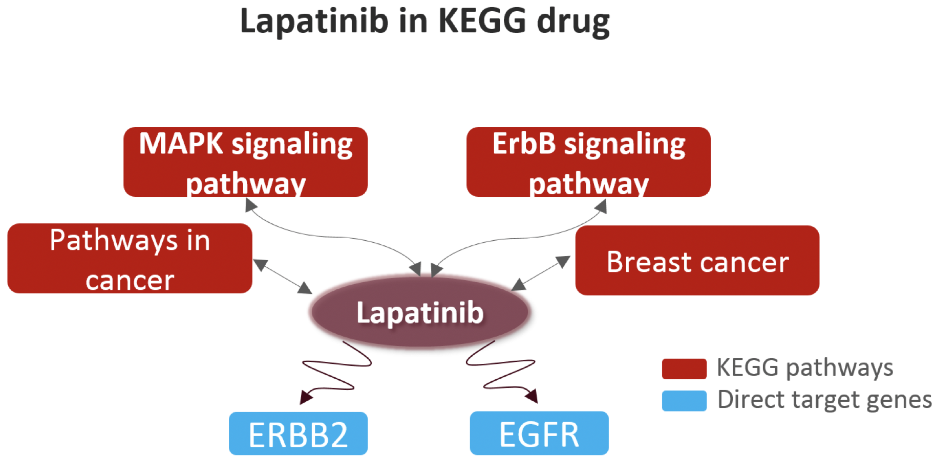
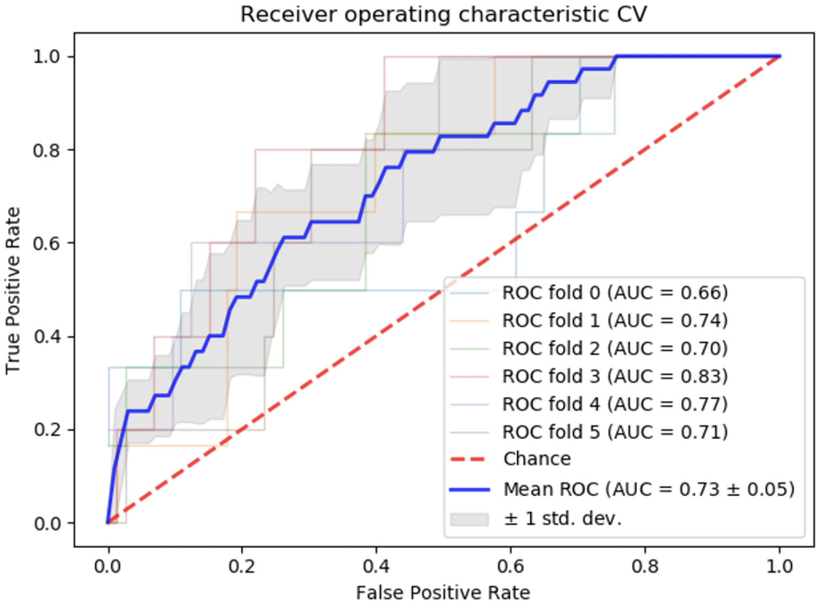
Evaluation of NERF
Case 1: Lapatinib resistance
Cancer Cell line Encyclopedia(CCLE)
439
Cell line counts
Drug-dose response dataset of Lapatinib
33
Sensitive
Resistant
Predict ‘Sensitive’ or ‘Resistant’ using gene expression data(51,115 ENSGs)
Train random forest model with 6-fold cross validation
Sample specific interpretation with NERF
vs.
Classic feature importance list
Test on independent cell lines use one of the cross validation models which the interested cell line is not in the training set

Slide 9
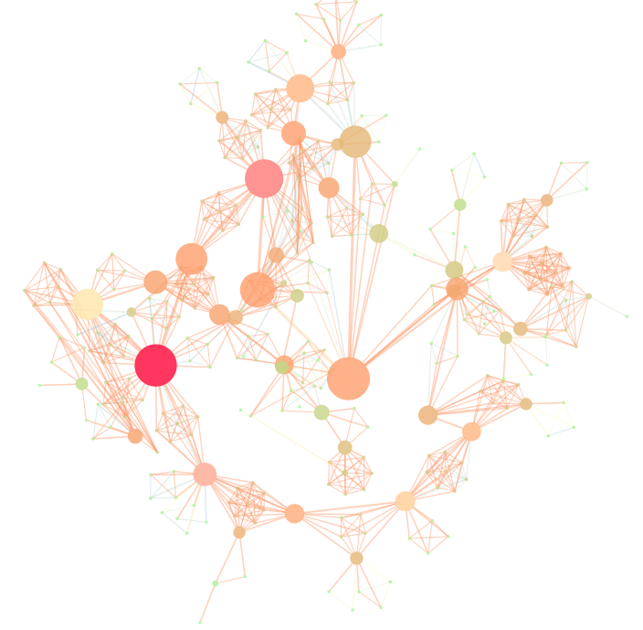
Using NERF to explain the sensitivity of BT474
Sensitive
BT474
Significantly enriched annotations in GEO Signatures of Differentially Expressed Genes for Kinase Perturbations
PIK3CA_druginhibition
Genes: KLF10, DIS3, HMBS, LARP7
PIK3CA_activemutant
Genes: IPO9, KRR1, PGAP3,CPVL
Notes:
Rank nodes using PageRank, edge intensity as weight
Enrich the top 50 genes in GEO Signatures of Differentially Expressed Genes for Kinase Perturbations

Slide 10
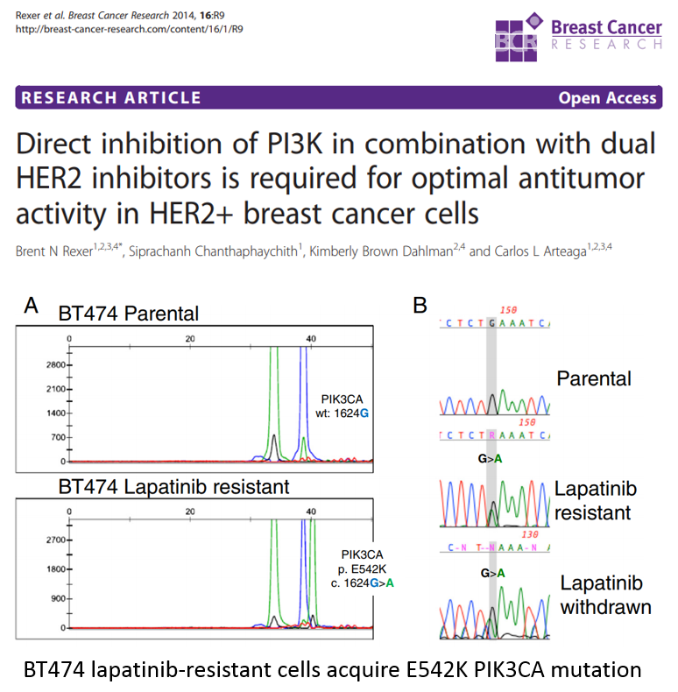
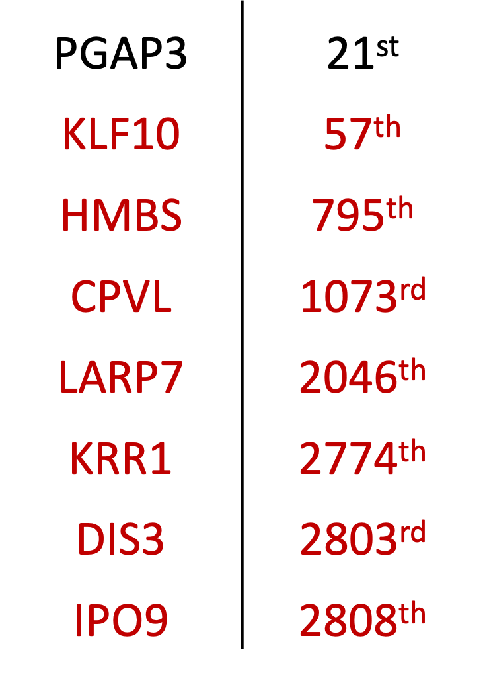
Does this interpretation make sense?
Ranking of important NERF genes in traditional feature importance list (3163 genes in total)
1. B. N. Rexer, S. Chanthaphaychith, K. B. Dahlman, and C. L. Arteaga, “Direct inhibition of PI3K in combination with dual HER2 inhibitors is required for optimal antitumor activity in HER2+ breast cancer cells,” Cancer Cell Signal. Target. Signal. Pathways Towar. Ther. Approaches to Cancer, pp. 55–80, 2014.

Slide 11
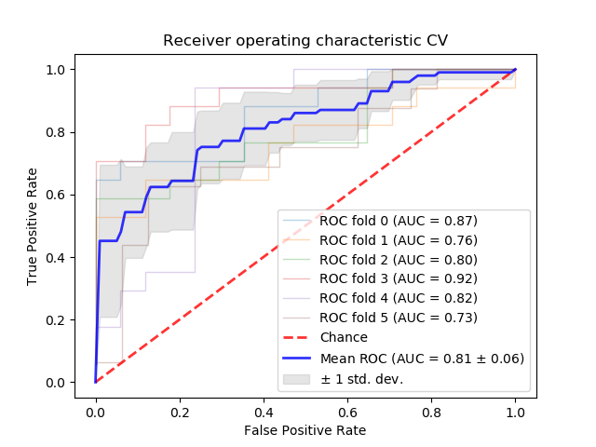
Evaluation of NERF
Case 2: TMZ resistance
A GBM-focused application:
Cell line data | TMZ resistance | Gene expression
?
TMZ resistance gene expression
RF + NERF
GDSC database
TMZ drug set
Expression of 10k+ genes, 200 cell lines (100R, 100S), 34 GBM cell lines included
100% accuracy GBM cell lines TMZ resistant prediction
AUROC of the cross-validation
Confusion matrix of the GBM cell lines predictions
 | Resistant to TMZ (Experimental) | Sensitive to TMZ (Experimental)
Resistant to TMZ (Predicted) | 28 | 0
Sensitive to TMZ (Predicted) | 0 | 6

Slide 12
1
34
?

Slide 13
To do 1 34+
NERF interpretation of all the GBM cell lines
For each sample’s interpretation, Pagerank
Downstream analysis
*
Among all the ranked list, pairwise rank-biased overlap, RBO
*
Cluster heatmap on the ranked list correlations, find blocks
*
Down streaming analysis for discovering using the block representatives

Slide 14
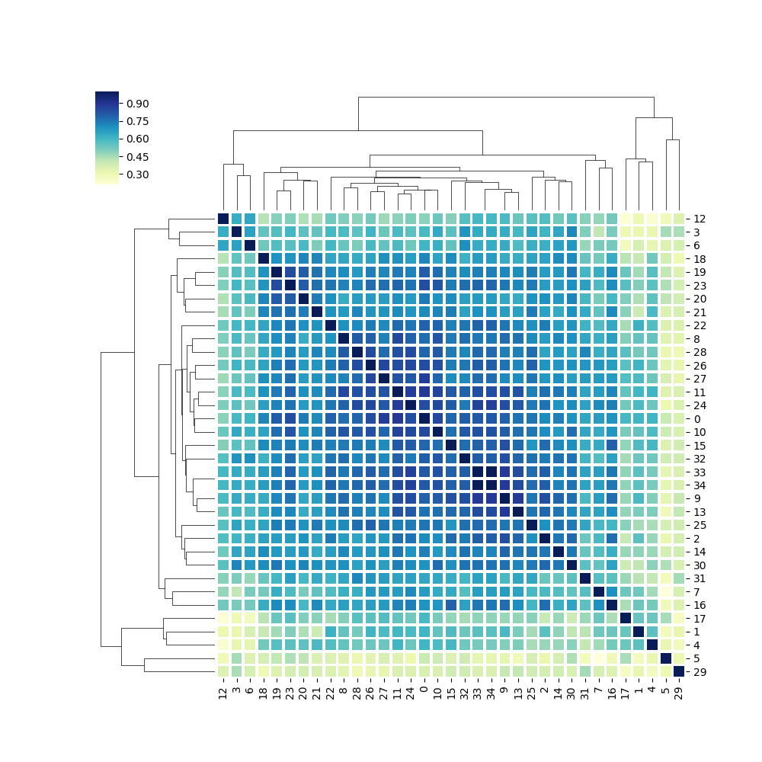
Clustered heatmap
based on NERF interpretation similarity
MGMT exp. level
0 SW1088
1 Becker
2 LN-405
3 LN-229
4 LN-18
5 KS-1
6 LNZTA3WT4
7 GB-1
8 U-118-MG
9 YH-13
10 SNB75
11 YKG-1
12 U251
13 T98G
14 U-87-MG
15 DK-MG
16 D-263MG
17 42-MG-BA
18 AM-38
19 CAS-1
20 A172
21 SK-MG-1
22 D-392MG
23 D-247MG
24 D-542MG
25 SF268
26 SF126
27 CCF-SaTTG1
28 SF295
29 8-MG-BA
30 DBTRG-05MG
31 D-423MG
32 M059J
33 D-566MG
2.44484
2.605229
2.523186
2.769268
7.421294
3.097215
3.064926
3.003804
5.131961
7.317325
3.041398
7.217328
3.061794
7.264154
3.234391
3.009986
4.54248
2.893669
3.46004
2.580349
2.782519
2.384256
7.327091
5.914423
2.726478
3.199078
2.578059
2.927356
2.414749
3.030724
2.939903
2.655561
2.710107
2.642725

Slide 15
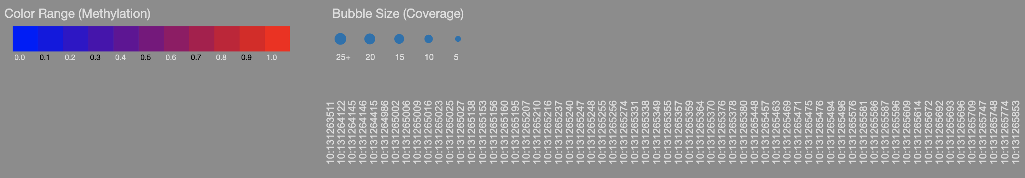
MGMT methylation
CpG position: Chr10: 131,265,470
hg19

Slide 16
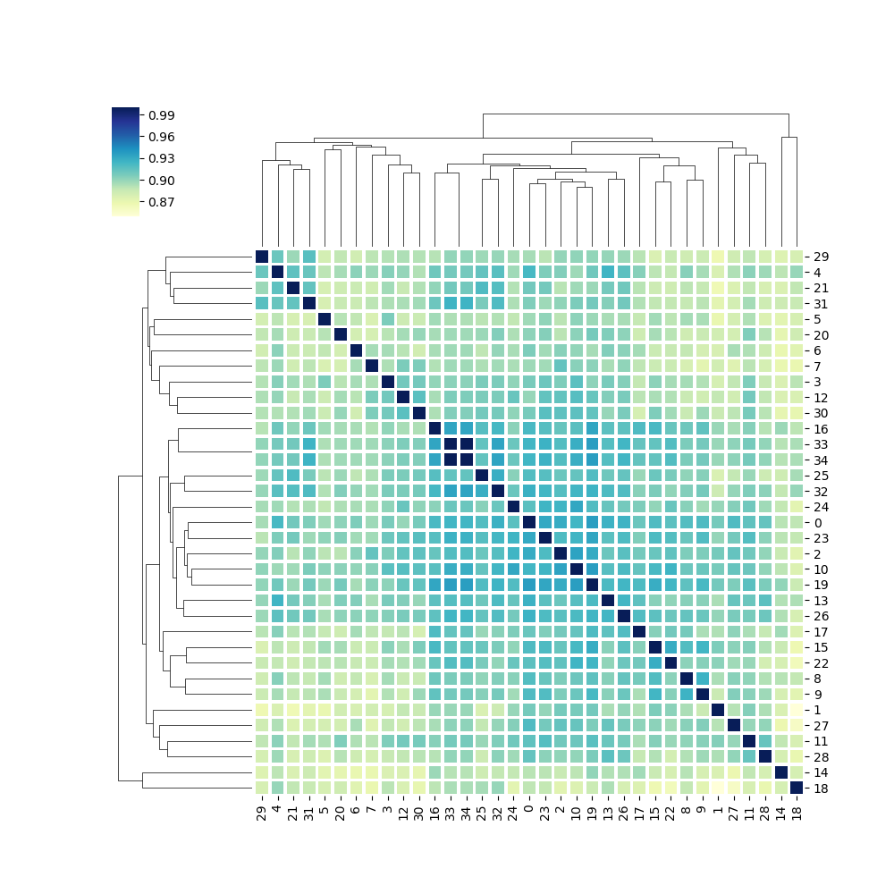
Is this pattern also presented in the correlation matrix of the gene expression?
*
*
*
*
*
*

Slide 17
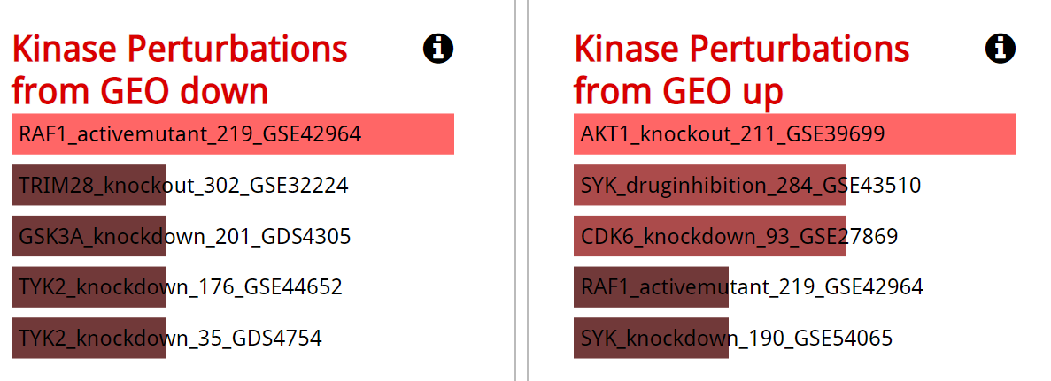
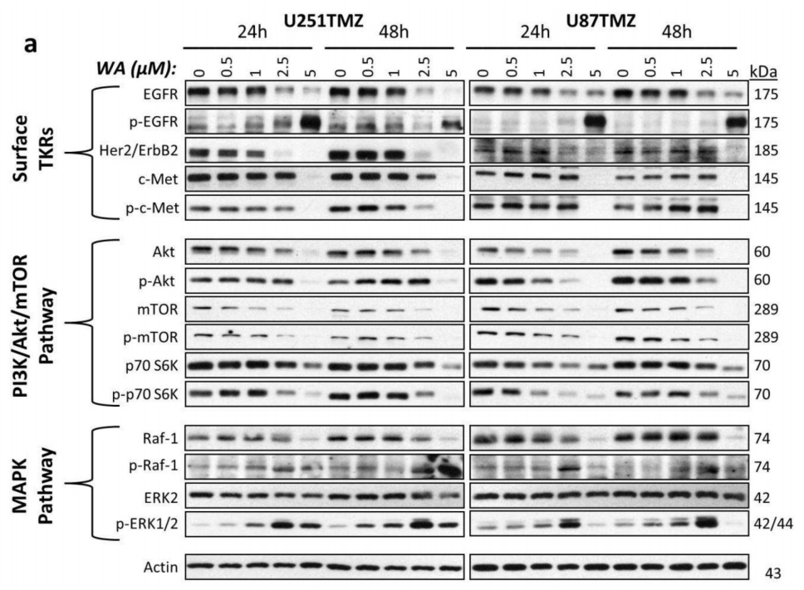
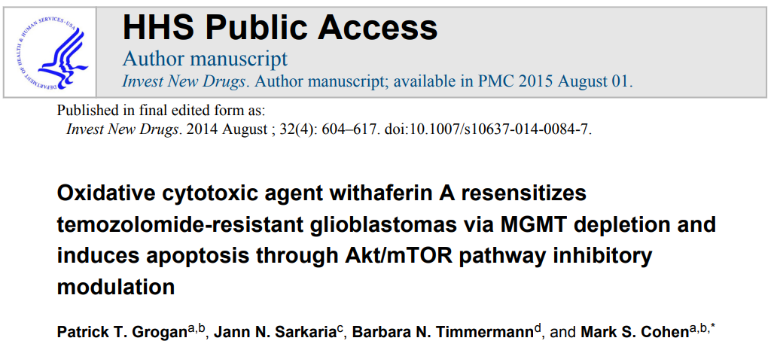
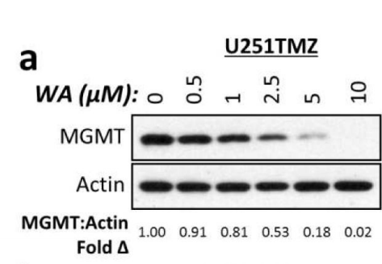
Sample 3: LN-229, sensitive

Slide 18
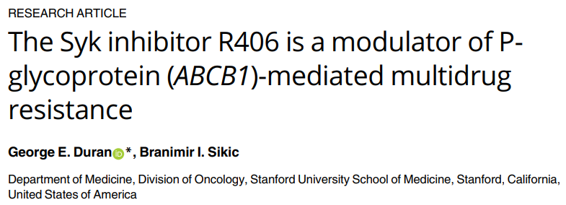
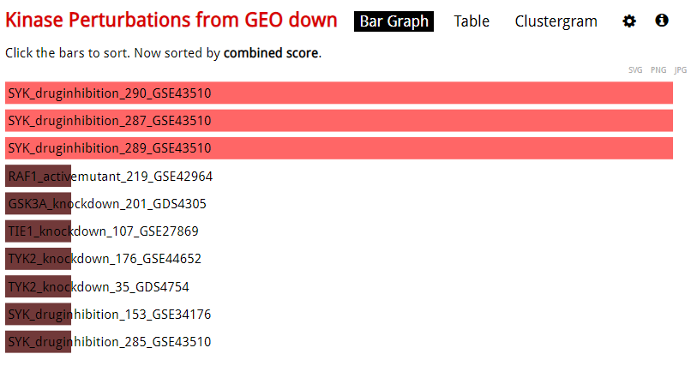
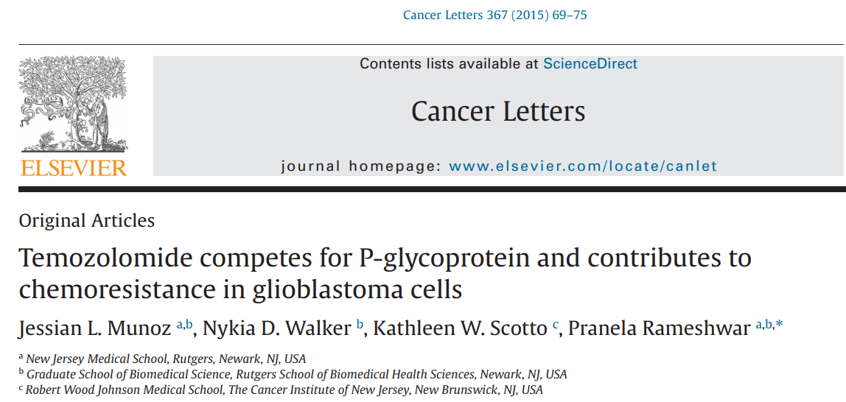
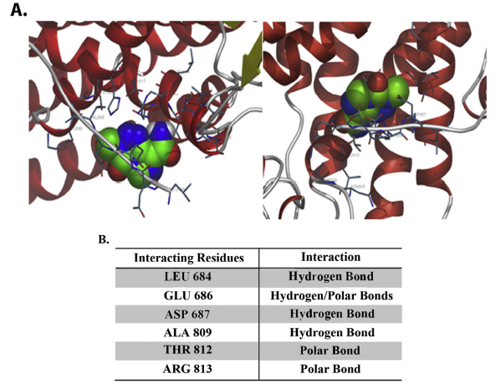
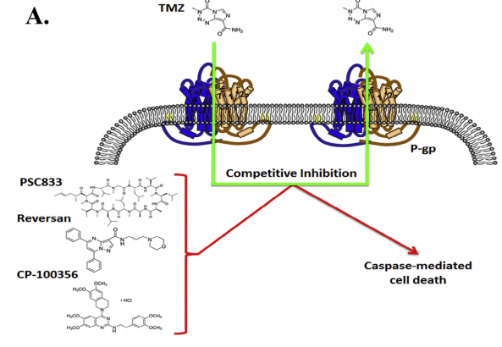
Sample 12: U251, sensitive
P value = 0.0073
Genes in SYK hits:
P2RY8 | CD53 | CORO1A | PYCR1| CCR7 |
CD48 | ARHGAP15 | MS4A1

Slide 19
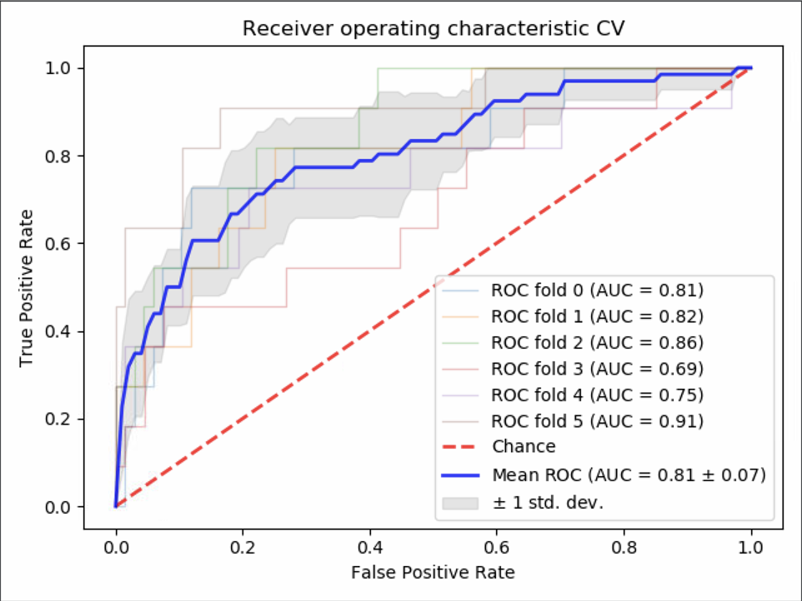
Evaluation of NERF
Case 3: AZD6244 (Selumetinib) resistance
| CCLE dataset
Mitogen-activated extracellular signal-regulated kinase (MEK1/2) inhibitor
Targets MEK(MAP2K) pathway, MAPK pathway
Treats Lung cancer, melanoma and colon cancer
AUROC of the cross-validation
Confusion matrix of the CRC cell lines predictions
 | Resistance (Experimental) | Sensitive (Experimental)
Resistance (Predicted) | 12 | 3
Sensitive (Predicted) | 0 | 7
Accuracy: 86.36%

Slide 20
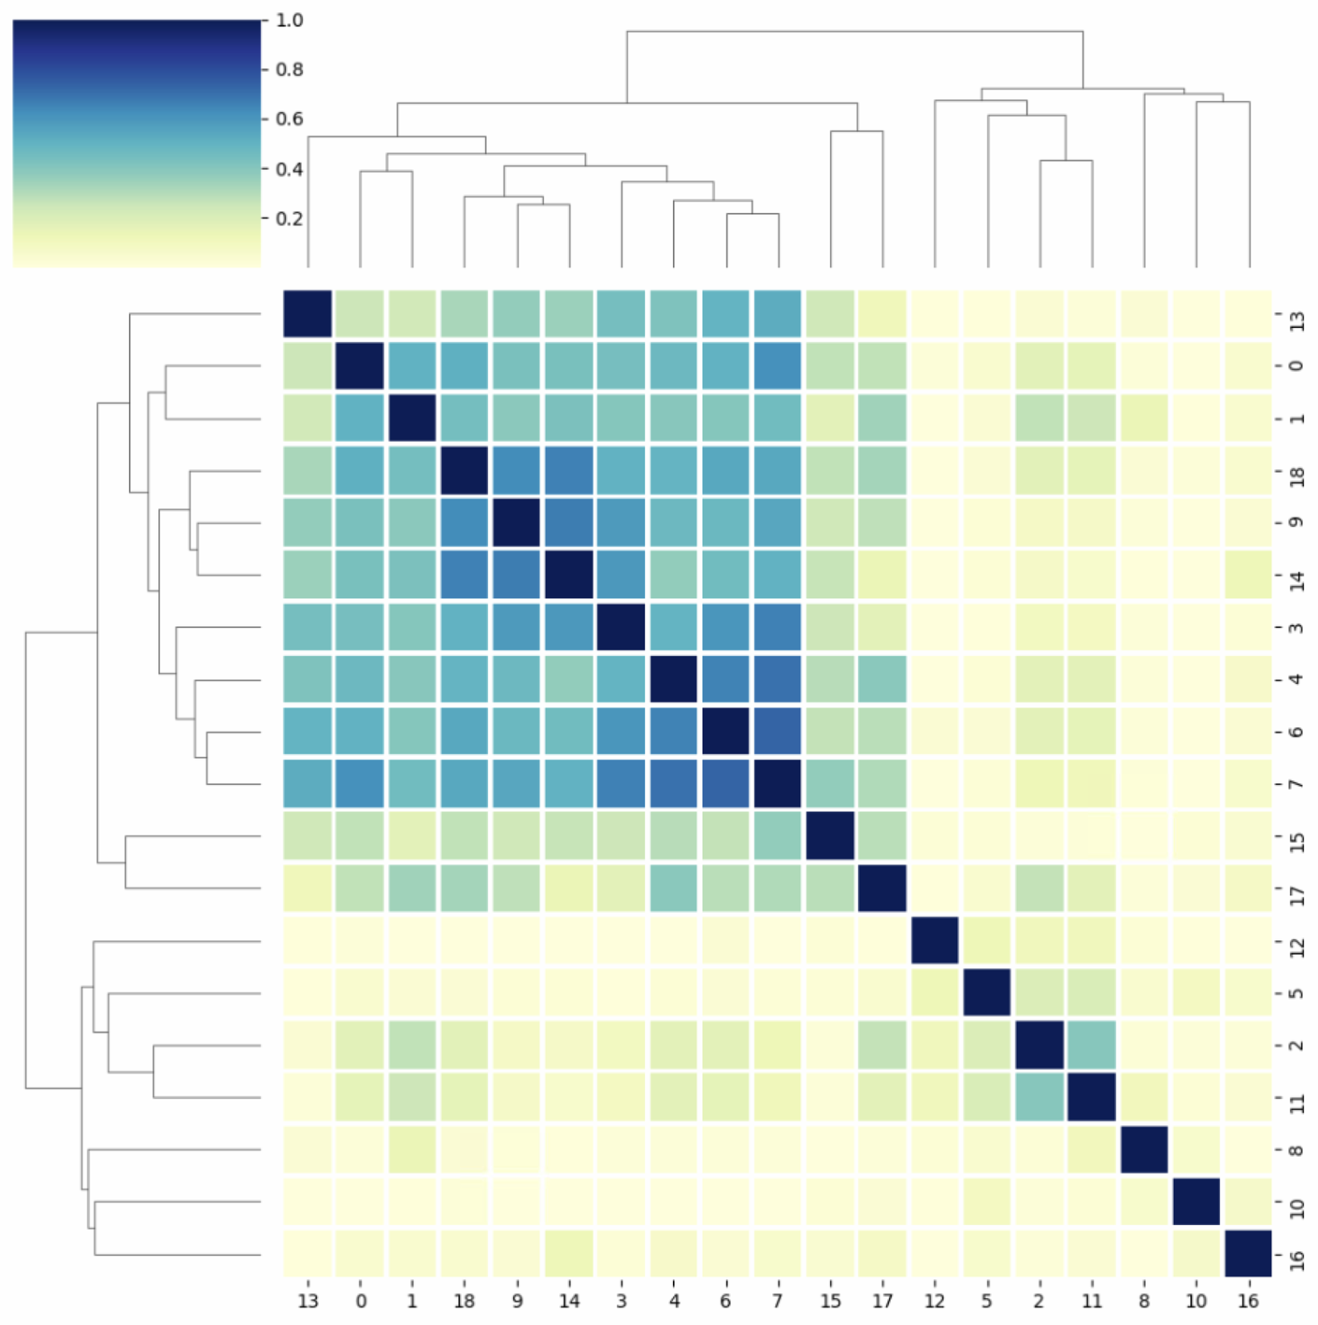
Resistance cell lines
Sensitive cell lines
0 | C2BBE1
1 | CCK81
2 | COLO201
3 | COLO320
4 | COLO678
5 | HCC56
6 | HCT116
7 | HCT15
8 | HT29
9 | LS123
10 | LS411N
11 | LS513
12 | NCIH747
13 | RKO
14 | SKCO1
15 | SNUC2A
16 | SW403
17 | SW480
18 | T84

Slide 21
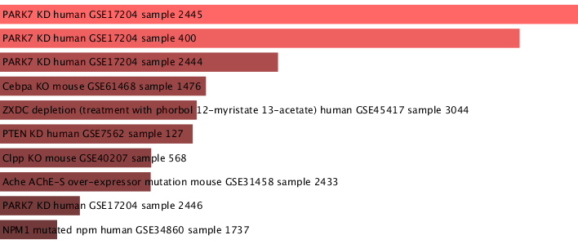
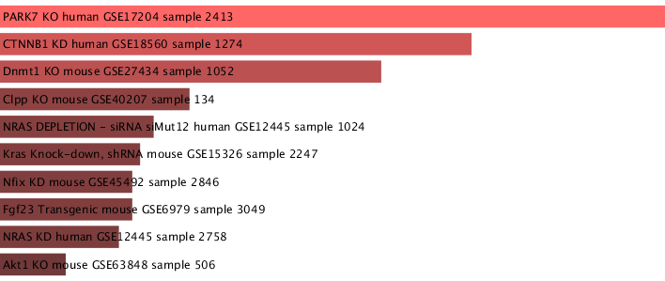
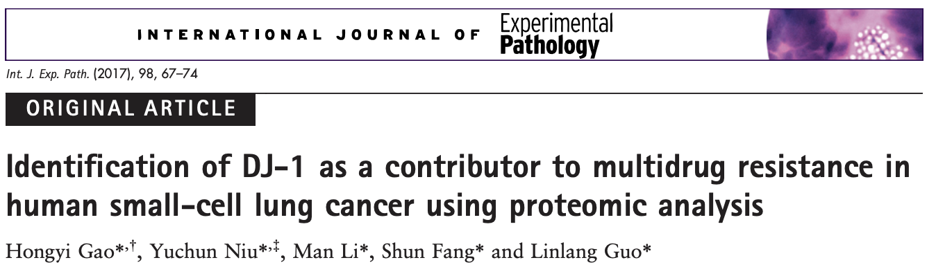
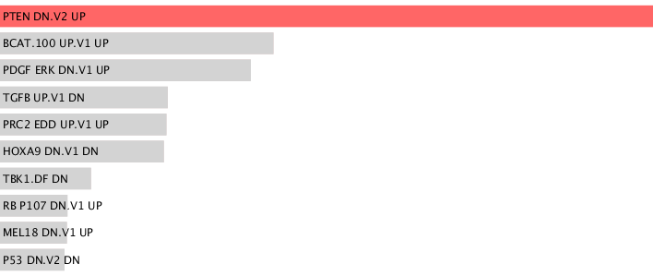
Top 50 NERF genes of several resistance cell lines enriched in PARK7(DJ-1) knockdown dataset
P value = 0.00323
P value = 0.0047
DJ-1 is also involved in the activation or repression of cell growth and cell death signaling pathways. Specifically, this polypeptide modulates p53 activity, the PI3K/Akt pathway by interacting with PTEN, and intervenes in the Raf/Erk pathway together with ras (Ariga, 2015).
MSigDB Oncogenic Signatures
P value = 0.00052
Notes:
RF find CITED1 Knockdown ann.

Slide 22
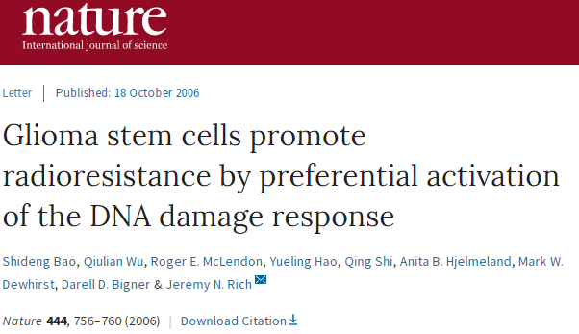
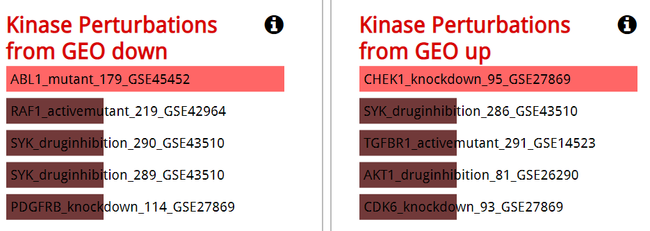
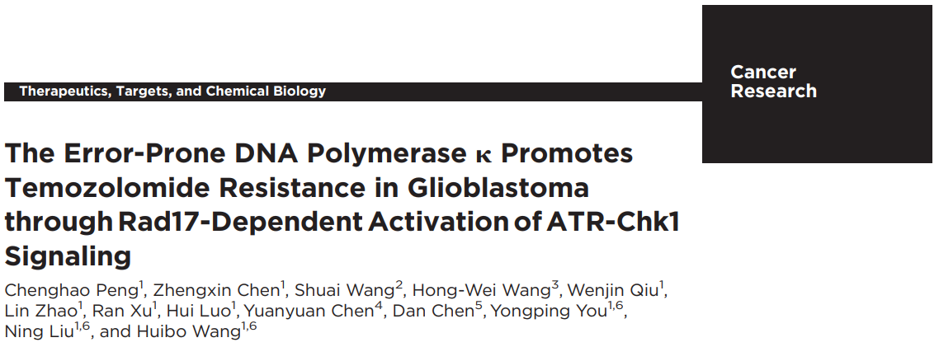
Sample 5: KS-1, sensitive
“In addition, the radioresistance of CD133-positive glioma stem cells can be reversed with a specific inhibitor of the Chk1 and Chk2 checkpoint kinases.”
“In this study, we show that Pol k mediates HR repair and temozolomide resistance in GBMs via Rad17-dependent activation of ATR-Chk1 signaling and may be leveraged as a novel potential therapeutic target for GBMs, even in relapsed/refractory settings.”

Slide 23
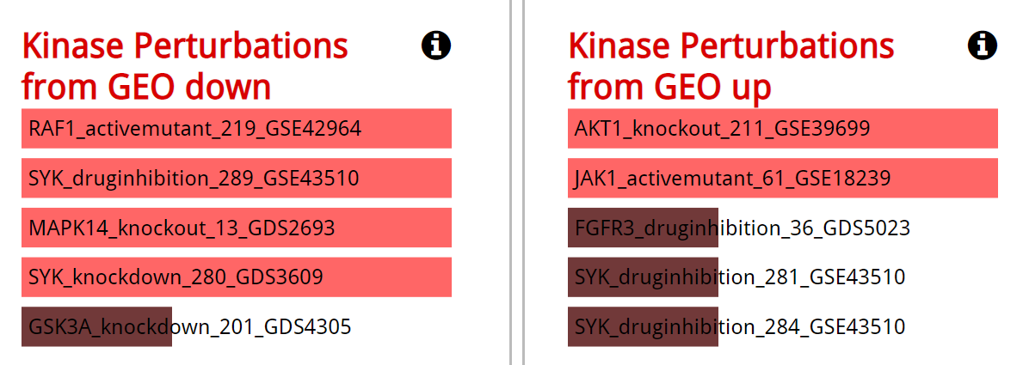
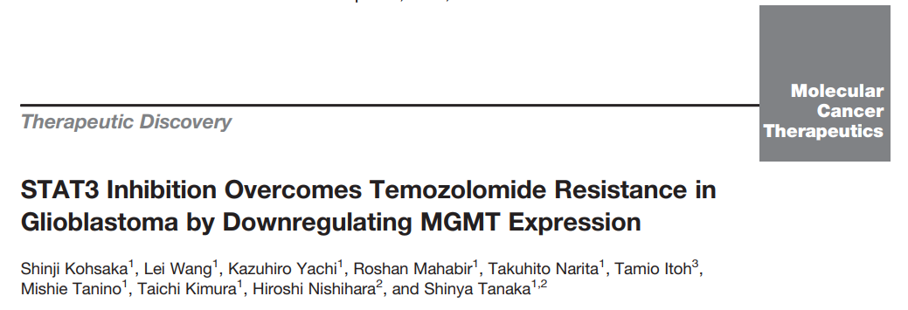
Sample 29: 8-MG-BA, sensitive
“We also observed that JAK inhibitor I downregulated
the expression of MGMT. However, STAT3 phosphorylation and MGMT expression did not completely synchronize compared with STAT3 inhibitor VI. This might be because JAK inhibitor I also inhibited Jak1, Jak2, Jak3 and Tyk2 and blocked STAT5 (51), and these off-target effects possibly inhibited the decrease of MGMT”

Slide 24
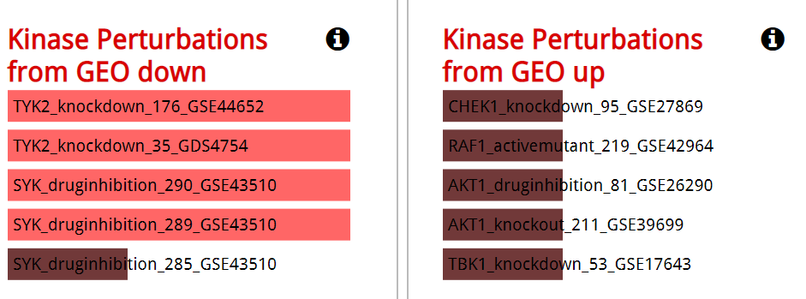
Top 50 genes ranked by traditional method

Slide 25
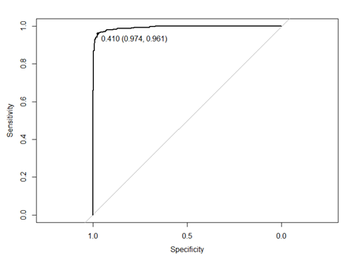

Test on Breast cancer classification task
RPPA data(expression data of 131 proteins)
TCGA breast cancer dataset
n=747
Train Random Forest model
And predict the class of
Clinical data
Histological type of cancer
n=1247
Two major histological types in breast cancer are:
Infiltrating Ductal Carcinoma(n=577 with RPPA data available)
Infiltrating Lobular Carcinoma(n=101 with RPPA data available)
D = 577
L = 101
“Oversampling”: Create ~500 of L to balance the data between the classes
Randomly select ~75% as training set, rest save for validation
~63.2% of samples in training set are used as “real training” samples
Repeat 10 times
Train a RF model with 500 trees
Check the out of bag errors (100-63.2)% first and then the validation (1-75)%

Slide 26
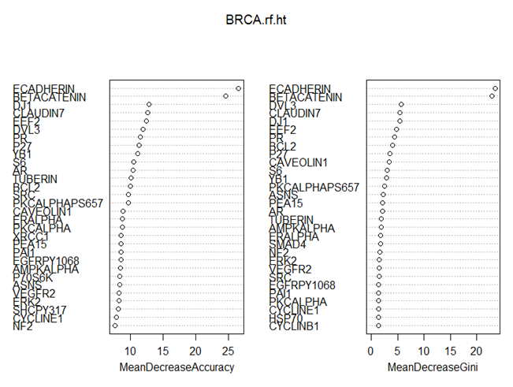
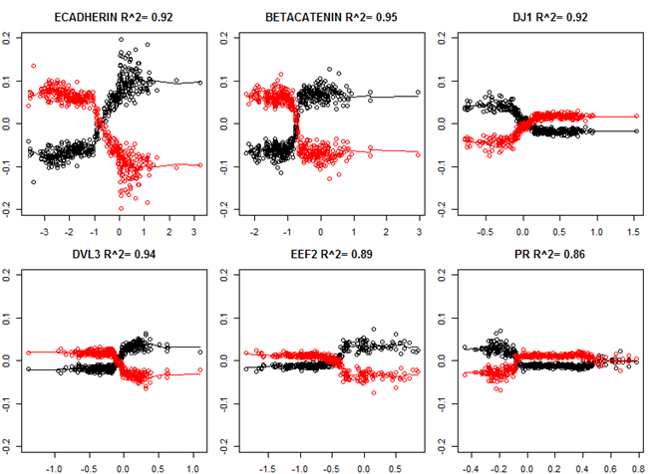
Feature importance by traditional method

Slide 27
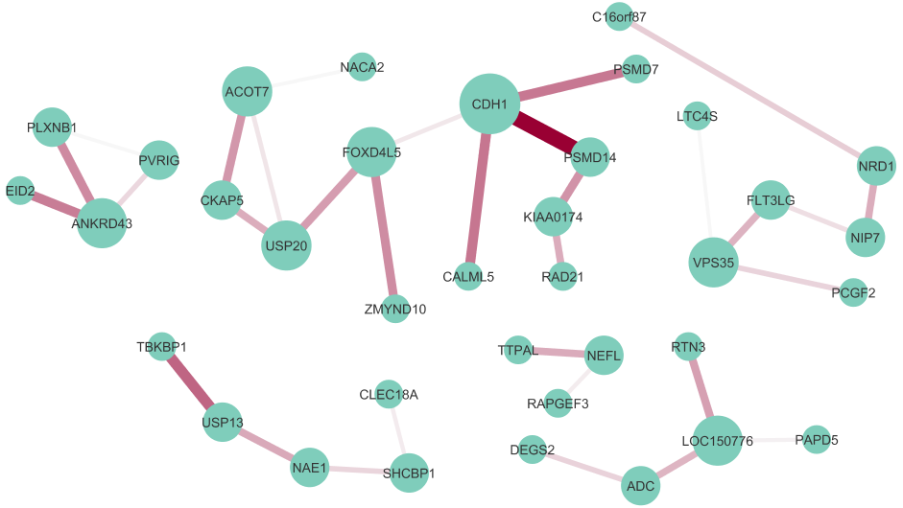
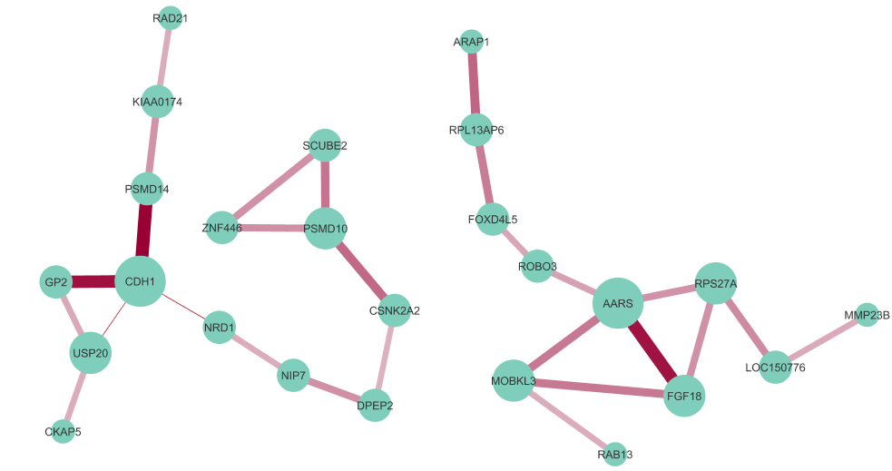
Lobular BRCA sample 1 center subnetworks
Lobular BRCA sample 2 center subnetworks

Slide 28
Summary and challenges
NERF pipeline is now established (Python package available via pip install)
Introducing PageRank helps the analysis of NERF networks, the (Network => list) conversion by PageRank keeps all the information in network
RBO similarity matrix allows a more globally view of multiple interpretations
Based on current evaluation experiment, NERF’s interpretation shows the potential of being biological meaningful
How to interpret/evaluate the interpretation quantitatively?
In progress: Test NERF on more drugs: PD0325901, PLX4720, Nutlin3, Erlotinib etc.

